Slide 1
Contingency table and its analysis
Appendix to lecture 3

Slide 2
Table of contents
1. Developing a contingency table
2. Conditional probability
3. Quetelet index
4. Chi-squared by Pearson
5. Chi-squared and average Quetelet

Slide 3
Part 1: Contingency table
Iris data: 150×4 table. Nominal features?
I need at least 3 of them.
Taxon: 3 categories, T1, T2, T3 (50 specimen each)
Two more to develop,
out of Sepal measurements,
Sepal Length and Sepal Width

Slide 4
Part 1: Contingency table
Iris data: 150×4 table. Nominal features?
To develop one out of
Sepal Length
take a look at S.L. histogram.
The minima define natural
boundaries
between categories to be.

Slide 5
Week 4. Contingency table
Iris data: 150×4 table. Nominal features?
Categories of Sepal Length,
are separated by the “breaks”
in its 20-bin Histogram.
This makes a set
>>a=[4 5.2 6.1 7.0 8]
of 5 border points, in which 4 and 8 mark the end points.

Slide 6
Part 1: Contingency table
Categories of Sepal Length
can be naturally defined by
the break and end points
>>a=[4 5.2 6.1 7.0 8]
A corresponding nominal feature g can be
defined, in Matlab, as follows:
>>for k=1:4;f=find(sl>=a(k) & sl<a(k+1));g(f)=k; end;
Here sl is a 150×1 array holding feature Sepal Length;
find, a command to put together indices of entities satisfying the predicate
sl>=a(k) & sl<a(k+1)); meaning “between the boundaries of k-th category, yet excluding one of them”, and g, the defined nominal feature.

Slide 7
Part 1: Contingency table
Iris data: 150×4 table. Nominal features?
To develop another one, out of Sepal Width,
specify the break and end points
in the histogram of the feature
and collect them as an array
>>b=[2 2.5 3.0 3.6 4.5]

Slide 8
Part 1: Contingency table
Categories of Sepal Width are
defined by the break and end
points in its histogram:
>>b=[2 2.5 3.0 3.6 4.5]
to generate a nominal feature h:
>>for k=1:4;f=find(sw>=b(k) & sw<b(k+1));h(f)=k; end;
Here sw is a feature Sepal Width 150×1 array;
find, a command to put together indices of entities satisfying the predicate
sw>=b(k) & sw<b(k+1)); meaning “between the boundaries of k-th category”,
and h, the defined nominal feature assigning label k to all those entities.

Slide 9
Part 1: Contingency table
The innate Taxon nominal feature t is generated in computer according to the rule: first 50 specimen belong to T1, next 50 to T2, and the last 50, to T3:
>>for k=1:3;f1=(k-1)*50+1; f2=k*50; t([f1:f2])=k; end;
Here f1:f2 is interval of integers between 1 and 50 at k=1, between 51 and 100 at k=2, and between 101 and 150 at k=3;
t, the nominal feature assigning label k to entities from taxon Tk (k=1, 2, 3).

Slide 10
Part 1: Contingency table
Contingency (Co-Occurrence) table for
Taxon Tk and Sepal_Length_Category Gl
19 in cell (T2,G3) is the number of entities that fall in both T2 and G3
Taxon | Sepal_Length_Category |  |  |  | Total
 | G1 | G2 | G3 | G4
T1 | 36 | 14 | 0 | 0 | 50
T2 | 4 | 26 | 19 | 1 | 50
T3 | 1 | 8 | 29 | 12 | 50
Total | 41 | 48 | 48 | 13 | 150

Slide 11
Part 1: Contingency table
Contingency (Co-Occurrence) table for
Taxon Tk and Sepal_Length_Category Gl
To make that in MatLab:
>> for k=1:3;for l=1:4; nl(k,l)=length(find(g==l & t==k));end;end
Taxon | Sepal_Length_Category |  |  |  | Total
 | G1 | G2 | G3 | G4
T1 | 36 | 14 | 0 | 0 | 50
T2 | 4 | 26 | 19 | 1 | 50
T3 | 1 | 8 | 29 | 12 | 50
Total | 41 | 48 | 48 | 13 | 150

Slide 12
Part 1: Contingency table
Contingency (Co-Occurrence) table for
Taxon Tk and Sepal_Length_Category Gl
Marginal frequencies are within-row sums and within-column sums – Tk and Gl category frequencies (since categories are disjoint)
Taxon | Sepal_Length_Category |  |  |  | Total
 | G1 | G2 | G3 | G4
T1 | 36 | 14 | 0 | 0 | 50
T2 | 4 | 26 | 19 | 1 | 50
T3 | 1 | 8 | 29 | 12 | 50
Total | 41 | 48 | 48 | 13 | 150

Slide 13
Part 1: Contingency table
Relative Contingency (Co-Occurrence) table for
Taxon Tk and Sepal_Length_Category Gl
Relative frequencies are proportions of the total number of entities (obtained by division of the frequencies by N, the total number)
Taxon | Sepal_Length_Category |  |  |  | Total
 | G1 | G2 | G3 | G4
T1 | 0.240 | 0.093 | 0 | 0 | 0.333
T2 | 0.027 | 0.173 | 0.127 | 0.007 | 0.333
T3 | 0.007 | 0.053 | 0.193 | 0.080 | 0.333
Total | 0.273 | 0.320 | 0.320 | 0.087 | 1

Slide 14
Part 2: Conditional Probability
Relation between row Tk and column Gl
NOTE: An inconsistency between table and plane conventions
In table On plane
T1
T2
T3
G1 G2 G3 G4
Row goes first X-axis (column!) goes first
Tk ⇒ Gl Gl ⇒ Tk
One should be aware of that and stick to either one (the plane’s of course)
Taxon | Sepal_Length_Category |  |  |  | Total
 | G1 | G2 | G3 | G4
T1 | 0.240 | 0.09 | 0 | 0 | 0.33
T2 | 0.027 | 0.17 | 0.12 | 0.007 | 0.33
T3 | 0.007 | 0.05 | 0.19 | 0.080 | 0.33
Totl | 0.273 | 0.32 | 0.32 | 0.087 | 1

Slide 15
Part 2: Conditional Probability 1
Taxon Tk and Sepal_Length_Category Gl
Conditional probability p(Tk|Gl) of taxon Tk given SL-category Gl: That is, within the category Gl.
Taxon | Sepal_Length_Category |  |  |  | Total
 | G1 | G2 | G3 | G4
T1 | 36/41 | 14/48 | 0/48 | 0/13 | 50
T2 | 4/41 | 26/48 | 19/48 | 1/13 | 50
T3 | 1/41 | 8/48 | 29/48 | 12/13 | 50
Total | 41 | 48 | 48 | 13 | 150

Slide 16
Part 2: Conditional Probability 2
Taxon Tk and Sepal_Length_Category Gl
Conditional probability p(Tk|Gl) of taxon Tk given SL-category Gl:
Those highlighted by bold are indicative, especially T1 given G1 and T3 given G4: almost conceptual rules G1⇒T1 and G4 ⇒T3.
Taxon | Sepal_Length_Category |  |  |  | Total
 | G1 | G2 | G3 | G4
T1 | 0.878 | 0.292 | 0 | 0 | 50
T2 | 0.098 | 0.542 | 0.396 | 0.077 | 50
T3 | 0.024 | 0.167 | 0.604 | 0.923 | 50
Total | 41 | 48 | 48 | 13 | 150

Slide 17
Part 2: Conditional Probability 3
Taxon Tk and Sepal_Length_Category Gl
Conditional probability p(Tk|Gl) of taxon Tk given SL-category Gl:
Some entries are indicative indeed.
Yet there can be dull contingency tables in which Conditional Probability is not helpful
Taxon | Sepal_Length_Category |  |  |  | Total
 | G1 | G2 | G3 | G4
T1 | 0.878 | 0.292 | 0 | 0 | 50
T2 | 0.098 | 0.542 | 0.396 | 0.077 | 50
T3 | 0.024 | 0.167 | 0.604 | 0.923 | 50
Total | 41 | 48 | 48 | 13 | 150

Slide 18
Compute Quetelet indices
Quetelet index q(Hk/Gl) of SW-categ. Hk given SL-categ. Gl
expressed per cent:
H4, given G4, is 82% more frequent than on average
This we could not see in the conditional probability table
SW Cat | Quetelet 100*q(Hk/Gl) |  |  |  | Prob. p(Hk)
 | G1 | G2 | G3 | G4
H1 | 33 | 42 | -43 | - 100 | 0.073
H2 | -76 | 36 | 29 | 0 | 0.301
H3 | 33 | -40 | 14 | - 6 | 0.493
H4 | 35 | 48 | -100 | 82 | 0.127

Slide 19
Compute Quetelet indices
Quetelet index q(h/g) of SW-categ. h given SL-categ. G:
H4, given G4, is 82% more frequent than on average
This we could not see using conditional probabilities:
Just the opposite:
p(H4|G4) =0.231,
the minimum
positive in its
column
SW-Cat | Cond. Probability SW|SL |  |  |  | Total
 | G1 | G2 | G3 | G4
H1 | 0.098 | 0.104 | 0.042 | 0 | 11
H2 | 0.073 | 0.417 | 0.396 | 0.308 | 46
H3 | 0.658 | 0.292 | 0.562 | 0.462 | 74
H4 | 0.171 | 0.188 | 0 | 0.231 | 19
Total | 41 | 48 | 48 | 13 | 150

Slide 20
Quetelet summary index
Co-occurrence relative frequency table for Sep_L & Sep_W
Summary Quetelet index is
the inner product of two tables,
that of co-occurrence and
Quetelet
Quetelet index table Q = 0.193,
that is, on average knowledge of
Gl “adds” 19.3% to frequency of
Hk
 | G1 | G2 | G3 | G4
H1 | 0.027 | 0.033 | 0.013 | 0
H2 | 0.020 | 0.133 | 0.127 | 0.027
H3 | 0.180 | 0.093 | 0.180 | 0.040
H4 | 0.047 | 0.060 | 0 | 0.020
 | G1 | G2 | G3 | G4
H1 | 0.33 | 0.42 | -0.43 | -1
H2 | -0.76 | 0.36 | 0.29 | 0
H3 | 0.33 | -0.40 | 0.14 | - 0.06
H4 | 0.35 | 0.48 | -1 | 0.82

Slide 21
Compute Quetelet indices
Quetelet index q(Hk/Gl) of SW-categ. Hk given SL-categ. Gl
expressed per cent:
H4, given G4, is 82% more frequent than on average
This we could not see in the conditional probability table
SW Cat | Quetelet 100*q(Hk/Gl) |  |  |  | Prob. p(Hk)
 | G1 | G2 | G3 | G4
H1 | 33 | 42 | -43 | - 100 | 0.073
H2 | -76 | 36 | 29 | 0 | 0.301
H3 | 33 | -40 | 14 | - 6 | 0.493
H4 | 35 | 48 | -100 | 82 | 0.127

Slide 22
Compute Quetelet indices
Quetelet index q(h/g) of SW-categ. h given SL-categ. G:
H4, given G4, is 82% more frequent than on average
This we could not see using conditional probabilities:
Just the opposite:
p(H4|G4) =0.231,
the minimum
positive in its
column
SW-Cat | Cond. Probability SW|SL |  |  |  | Total
 | G1 | G2 | G3 | G4
H1 | 0.098 | 0.104 | 0.042 | 0 | 11
H2 | 0.073 | 0.417 | 0.396 | 0.308 | 46
H3 | 0.658 | 0.292 | 0.562 | 0.462 | 74
H4 | 0.171 | 0.188 | 0 | 0.231 | 19
Total | 41 | 48 | 48 | 13 | 150

Slide 23
Quetelet summary index
Co-occurrence relative frequency table for Sep_L & Sep_W
Summary Quetelet index is
the inner product of two tables,
that of co-occurrence and
Quetelet
Quetelet index table Q = 0.193,
that is, on average knowledge of
Gl “adds” 19.3% to frequency of
Hk
 | G1 | G2 | G3 | G4
H1 | 0.027 | 0.033 | 0.013 | 0
H2 | 0.020 | 0.133 | 0.127 | 0.027
H3 | 0.180 | 0.093 | 0.180 | 0.040
H4 | 0.047 | 0.060 | 0 | 0.020
 | G1 | G2 | G3 | G4
H1 | 0.33 | 0.42 | -0.43 | -1
H2 | -0.76 | 0.36 | 0.29 | 0
H3 | 0.33 | -0.40 | 0.14 | - 0.06
H4 | 0.35 | 0.48 | -1 | 0.82

Slide 24
Part 3: Chi-Squared Coefficient - a different development
Contingency table Marginal column
Marginal row
Sepal_Width_Category Hk & Sepal_Length_Category Gl
Dividing that by N=150, brings forward:
SW-Cat | Sepal_Length_Category |  |  |  | Total
 | G1 | G2 | G3 | G4
H1 | 4 | 5 | 2 | 0 | 11
H2 | 3 | 20 | 19 | 4 | 46
H3 | 27 | 14 | 27 | 6 | 74
H4 | 7 | 9 | 0 | 3 | 19
Total | 41 | 48 | 48 | 13 | 150

Slide 25
Part 3: Chi-Squared Coefficient
Sepal_Width_Category h & Sepal_Length_Category g
Contingency relative frequency table (totaling to 1)
SW-Cat | Sepal_Length_Category |  |  |  | Total
 | G1 | G2 | G3 | G4
H1 | 0.027 | 0.033 | 0.013 | 0 | 0.073
H2 | 0.020 | 0.133 | 0.127 | 0.027 | 0.307
H3 | 0.180 | 0.093 | 0.180 | 0.040 | 0.493
H4 | 0.047 | 0.060 | 0 | 0.020 | 0.127
Total | 0.273 | 0.320 | 0.320 | 0.087 | 1

Slide 26
Part 3: Chi-Squared Coefficient
Contingency relative frequency table
Karl Pearson (1867-1936): The two features are to be tested on independence
What is that?
SW-Cat | Sepal_Length_Category |  |  |  | Total
 | G1 | G2 | G3 | G4
H1 | 0.027 | 0.033 | 0.013 | 0 | 0.073
H2 | 0.020 | 0.133 | 0.127 | 0.027 | 0.307
H3 | 0.180 | 0.093 | 0.180 | 0.040 | 0.493
H4 | 0.047 | 0.060 | 0 | 0.020 | 0.127
Total | 0.273 | 0.320 | 0.320 | 0.087 | 1

Slide 27
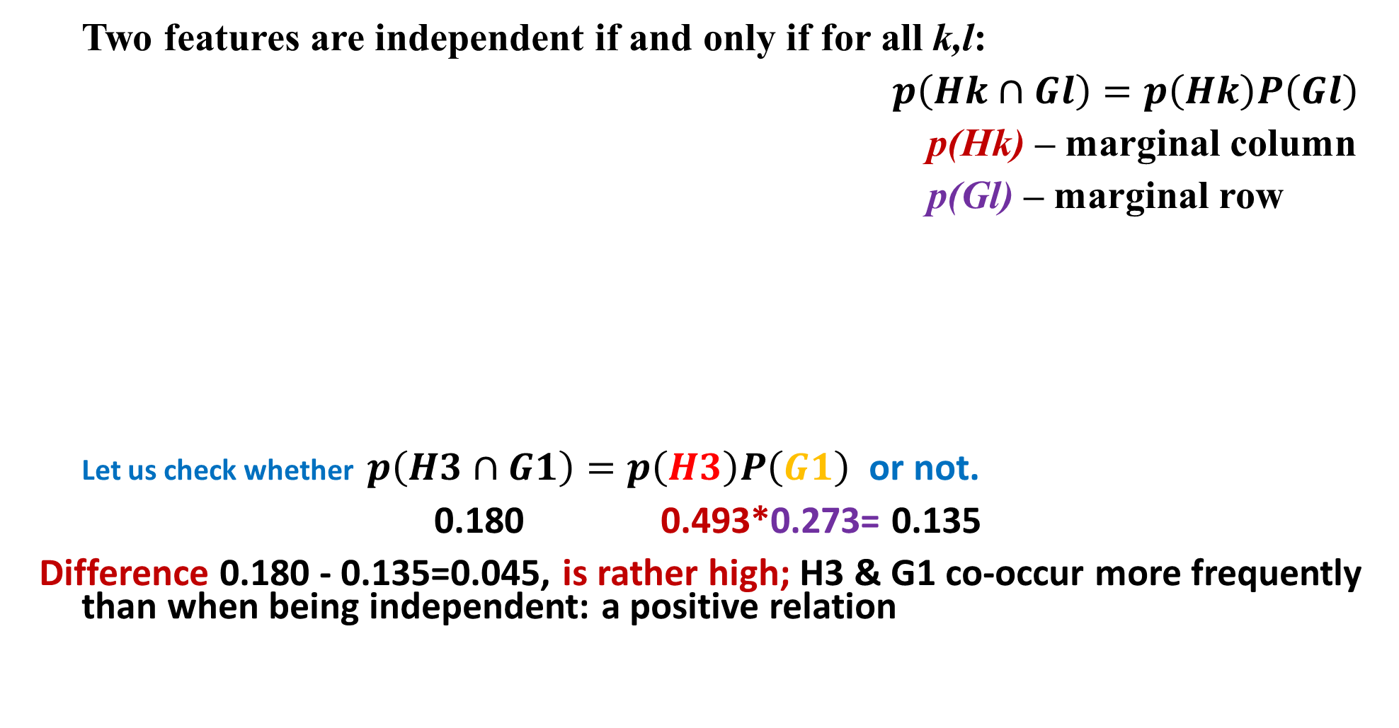
Part 3: Pearson’s Chi-Squared
Two features are independent if and only if for all k,l:
$p\left(Hk∩Gl\right)=p\left(Hk\right)P\left(Gl\right)$
p(Hk) – marginal column
p(Gl) – marginal row
Let us check whether $p\left(H3∩G1\right)=p\left(H3\right)P\left(G1\right)$ or not.
0.180 0.493*0.273= 0.135
Difference 0.180 - 0.135=0.045, is rather high; H3 & G1 co-occur more frequently than when being independent: a positive relation
SW-Cat | Sepal_Length_Category |  |  |  | Total
 | G1 | G2 | G3 | G4
H1 | 0.027 | 0.033 | 0.013 | 0 | 0.073
H2 | 0.020 | 0.133 | 0.127 | 0.027 | 0.307
H3 | 0.180 | 0.093 | 0.180 | 0.040 | 0.493
H4 | 0.047 | 0.060 | 0 | 0.020 | 0.127
Total | 0.273 | 0.320 | 0.320 | 0.087 | 1

Slide 28
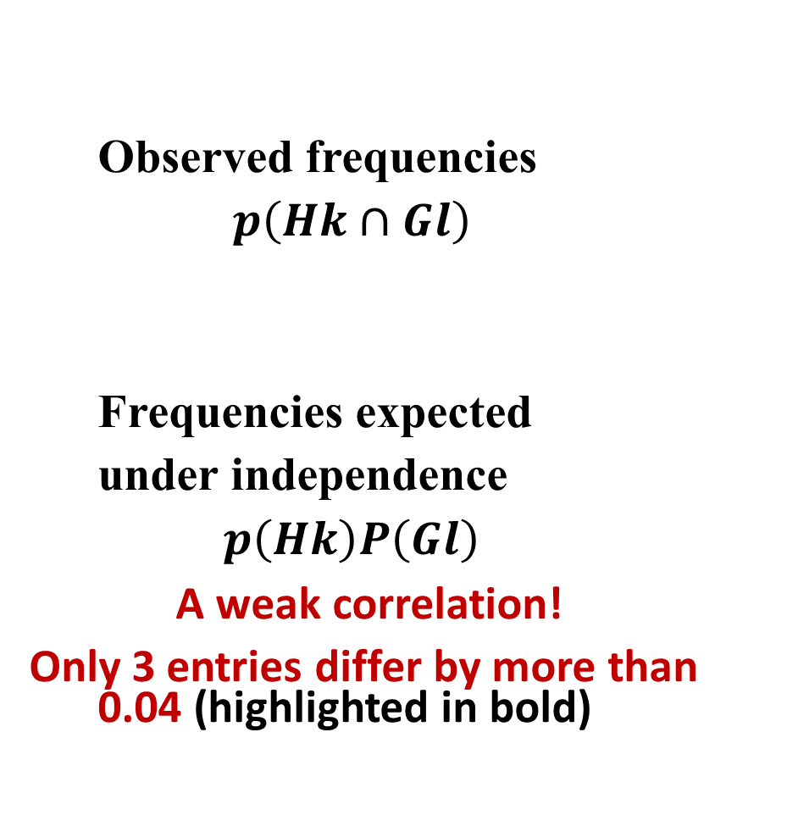
Part 3: Pearson’s Chi-Squared
Observed frequencies
$$p\left(Hk∩Gl\right)$$
Frequencies expected
under independence
$$p\left(Hk\right)P\left(Gl\right)$$
A weak correlation!
Only 3 entries differ by more than 0.04 (highlighted in bold)
0.027 | 0.033 | 0.013 | 0 | 0.073
0.020 | 0.133 | 0.127 | 0.027 | 0.307
0.180 | 0.093 | 0.180 | 0.040 | 0.493
0.047 | 0.060 | 0 | 0.020 | 0.127
0.273 | 0.320 | 0.320 | 0.087 | 1
0.020 | 0.024 | 0.024 | 0.006 | 0.073
0.084 | 0.098 | 0.098 | 0.027 | 0.307
0.135 | 0.158 | 0.158 | 0.043 | 0.493
0.035 | 0.040 | 0.040 | 0.011 | 0.127
0.273 | 0.320 | 0.320 | 0.087 | 1

Slide 29
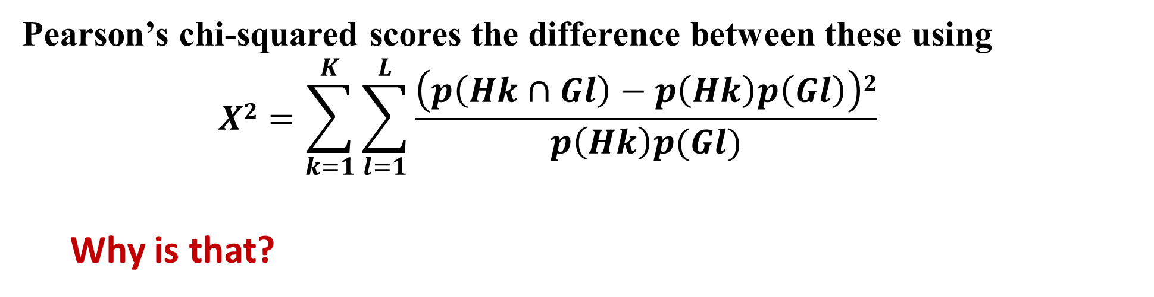
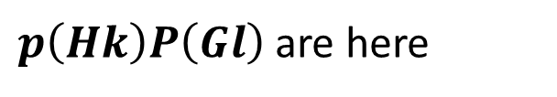
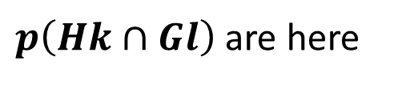
Part 3: Pearson’s Chi-Squared
$p\left(Hk∩Gl\right)$ are here
$p\left(Hk\right)P\left(Gl\right)$ are here
0.027 | 0.033 | 0.013 | 0 | 0.073
0.020 | 0.133 | 0.127 | 0.027 | 0.307
0.180 | 0.093 | 0.180 | 0.040 | 0.493
0.047 | 0.060 | 0 | 0.020 | 0.127
0.273 | 0.320 | 0.320 | 0.087 | 1
0.020 | 0.024 | 0.024 | 0.006 | 0.073
0.084 | 0.098 | 0.098 | 0.027 | 0.307
0.135 | 0.158 | 0.158 | 0.043 | 0.493
0.035 | 0.040 | 0.040 | 0.011 | 0.127
0.273 | 0.320 | 0.320 | 0.087 | 1
Pearson’s chi-squared scores the difference between these using
$$X2=\sum_{k=1}^{K}{\sum_{l=1}^{L}{\frac{\left(p\left(Hk∩Gl\right)−p\left(Hk\right)p\left(Gl\right)\right)2}{p\left(Hk\right)p(Gl)}}}$$
Why is that?

Slide 30
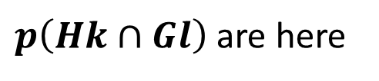
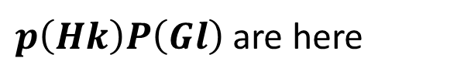
Part 3: Pearson’s Chi-Squared
$p\left(Hk∩Gl\right)$ are here
$p\left(Hk\right)P\left(Gl\right)$ are here
0.027 | 0.033 | 0.013 | 0 | 0.073
0.020 | 0.133 | 0.127 | 0.027 | 0.307
0.180 | 0.093 | 0.180 | 0.040 | 0.493
0.047 | 0.060 | 0 | 0.020 | 0.127
0.273 | 0.320 | 0.320 | 0.087 | 1
0.020 | 0.024 | 0.024 | 0.006 | 0.073
0.084 | 0.098 | 0.098 | 0.027 | 0.307
0.135 | 0.158 | 0.158 | 0.043 | 0.493
0.035 | 0.040 | 0.040 | 0.011 | 0.127
0.273 | 0.320 | 0.320 | 0.087 | 1
Why is X²?
Pearson: Under the hypothesis that the features are independent in the population, and entity sampling has been done randomly and independently, the density function of random variable NX² tends to distribution χ² with (K-1)(L-1) degrees of freedom.
Notes: 1. In many textbooks, it is the value of NX² which is denoted by X², while denoting our X² by ϕ².
2. This theorem allows for probabilistic testing of the hypothesis that the features are independent (see next slide).

Slide 31
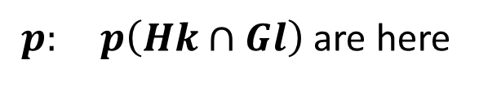

Part 3: Pearson’s Chi-Squared
$p: p\left(Hk∩Gl\right)$ are here
pn: $p\left(Hk\right)P\left(Gl\right)$ are here
0.027 | 0.033 | 0.013 | 0 | 0.073
0.020 | 0.133 | 0.127 | 0.027 | 0.307
0.180 | 0.093 | 0.180 | 0.040 | 0.493
0.047 | 0.060 | 0 | 0.020 | 0.127
0.273 | 0.320 | 0.320 | 0.087 | 1
0.020 | 0.024 | 0.024 | 0.006 | 0.073
0.084 | 0.098 | 0.098 | 0.027 | 0.307
0.135 | 0.158 | 0.158 | 0.043 | 0.493
0.035 | 0.040 | 0.040 | 0.011 | 0.127
0.273 | 0.320 | 0.320 | 0.087 | 1
Pearson: Under the hypothesis that the features are independent in the population, and entity sampling has been done randomly and independently, the density function of random variable NX² tends to distribution χ² with f=(K-1)(L-1) degrees of freedom.
Apply this theorem to our case.
We have K=4, L=4, therefore f=9. At f=9, there is a 5% chance that the NX² value will be greater than 16.92 if the hypothesis of independence is true. In our case X² =0.1929, N=150 so that NX² =28.93 > 16.92. The hypothesis is to be rejected with 95% confidence. In fact, it is rejected even with 99.9% confidence, because the critical value in this case is 27.88. Amusingly, if there were only 50 specimen, NX² =9.64, and the independence could not be rejected.

Slide 32
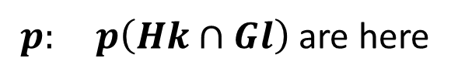

Part 3: Pearson’s Chi-Squared
$p: p\left(Hk∩Gl\right)$ are here
pn: $p\left(Hk\right)P\left(Gl\right)$ are here
0.027 | 0.033 | 0.013 | 0 | 0.073
0.020 | 0.133 | 0.127 | 0.027 | 0.307
0.180 | 0.093 | 0.180 | 0.040 | 0.493
0.047 | 0.060 | 0 | 0.020 | 0.127
0.273 | 0.320 | 0.320 | 0.087 | 1
0.020 | 0.024 | 0.024 | 0.006 | 0.073
0.084 | 0.098 | 0.098 | 0.027 | 0.307
0.135 | 0.158 | 0.158 | 0.043 | 0.493
0.035 | 0.040 | 0.040 | 0.011 | 0.127
0.273 | 0.320 | 0.320 | 0.087 | 1
Pearson: Under the hypothesis that the features are independent in the population, and entity sampling has been done randomly and independently, the density function of random variable NX² tends to distribution χ² with f=(K-1)(L-1) degrees of freedom.
Hence, in the statistics textbooks, the chi-squared is not recommended as a measure of association between features.

Slide 33
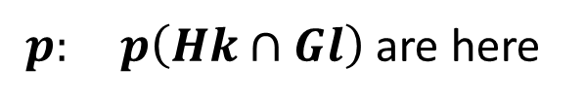

Pearson’s Chi-Squared is Q
$p: p\left(Hk∩Gl\right)$ are here
pn: $p\left(Hk\right)P\left(Gl\right)$ are here
0.027 | 0.033 | 0.013 | 0 | 0.073
0.020 | 0.133 | 0.127 | 0.027 | 0.307
0.180 | 0.093 | 0.180 | 0.040 | 0.493
0.047 | 0.060 | 0 | 0.020 | 0.127
0.273 | 0.320 | 0.320 | 0.087 | 1
0.020 | 0.024 | 0.024 | 0.006 | 0.073
0.084 | 0.098 | 0.098 | 0.027 | 0.307
0.135 | 0.158 | 0.158 | 0.043 | 0.493
0.035 | 0.040 | 0.040 | 0.011 | 0.127
0.273 | 0.320 | 0.320 | 0.087 | 1
MatLab’s computation of the chi-squared chi2:
>> d=p-pn; dd=d.*d; chi=dd./pn; chi2=sum(sum(chi)) %=0.1929
MatLab’s computation of the summary Quetelet qs:
>> q=p./pn -1; qq=p.*q; qs=sum(sum(qq)%=0.1929
Here .*, ./ are the operations over corresponding entries, and p, pn are arrays being 4×4 substance fragments of the respective tables above.

Slide 34
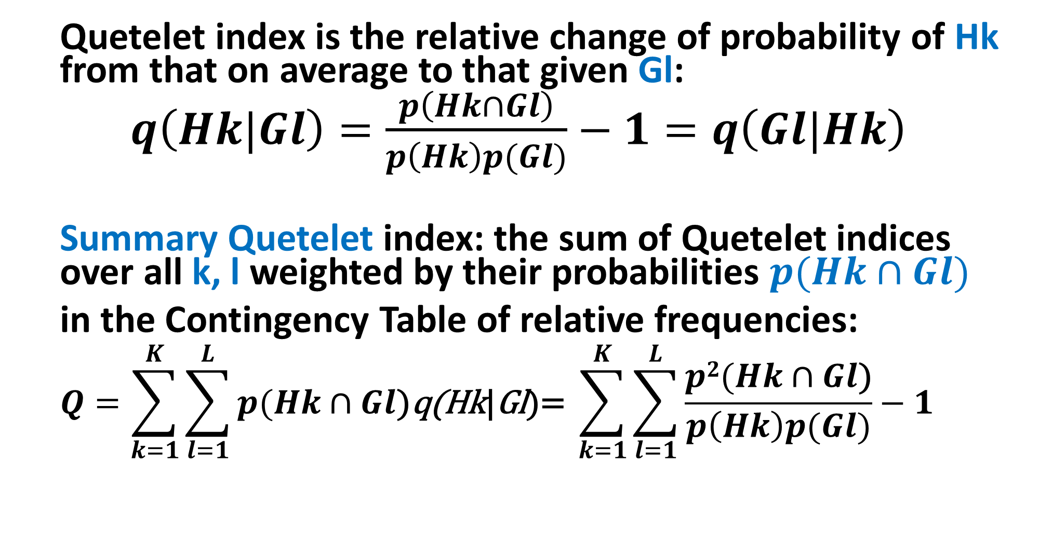
Summary Quetelet index- some maths
Quetelet index is the relative change of probability of Hk from that on average to that given Gl:
$q\left(Hk|Gl\right)=\frac{p\left(Hk∩Gl\right)}{p\left(Hk\right)p(Gl)}−1=q\left(Gl|Hk\right)$
Summary Quetelet index: the sum of Quetelet indices over all k, l weighted by their probabilities $p(Hk∩Gl)$
in the Contingency Table of relative frequencies:
$$Q=\sum_{k=1}^{K}{\sum_{l=1}^{L}{p(Hk∩Gl\text{)}\text{q}\text{(}\text{Hk}\text{|}\text{Gl}\text{)=} }\sum_{k=1}^{K}{\sum_{l=1}^{L}{\frac{p2(Hk∩Gl\text{)}}{p\left(Hk\right)p(Gl)}−1 }}}$$

Slide 35
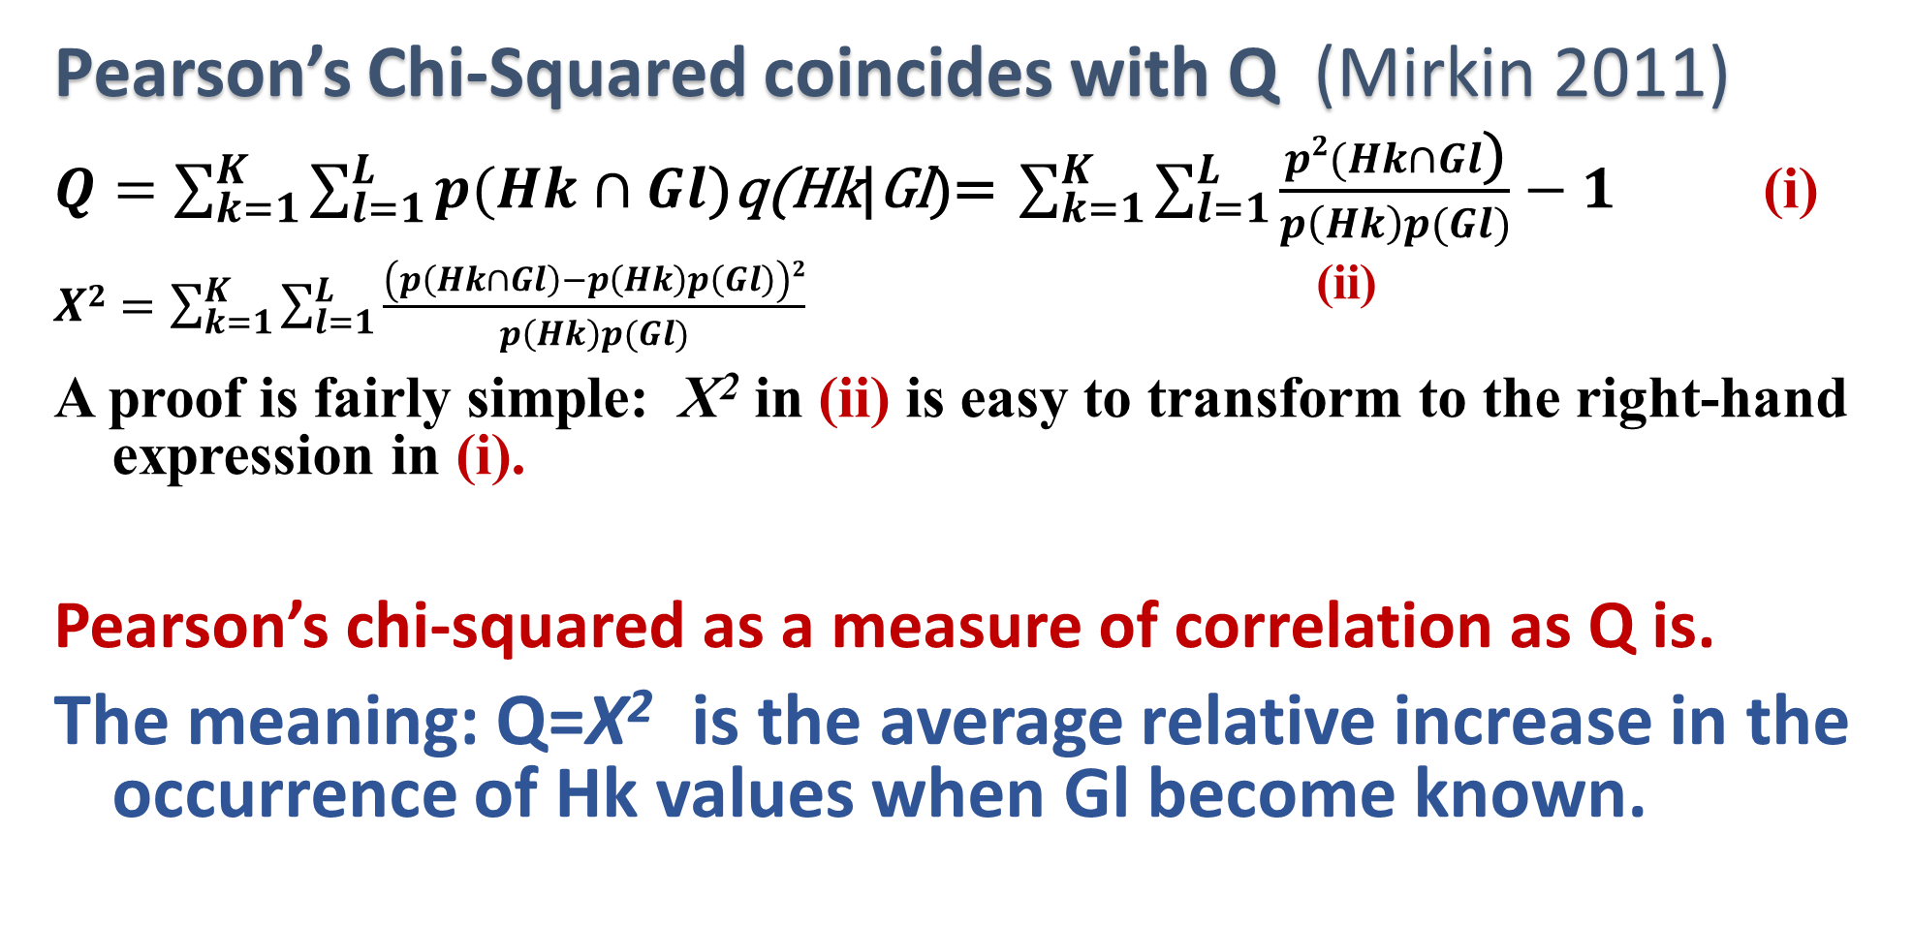
Part 4: Pearson’s Chi-Squared is Q
Pearson’s Chi-Squared coincides with Q (Mirkin 2011)
$Q=\sum_{k=1}^{K}{\sum_{l=1}^{L}{p(Hk∩Gl\text{)}\text{q}\text{(}\text{Hk}\text{|}\text{Gl}\text{)=} }\sum_{k=1}^{K}{\sum_{l=1}^{L}{\frac{p2(Hk∩Gl\text{)}}{p\left(Hk\right)p(Gl)}−1 }}}$ (i)
$X2=\sum_{k=1}^{K}{\sum_{l=1}^{L}{\frac{\left(p\left(Hk∩Gl\right)−p\left(Hk\right)p\left(Gl\right)\right)2}{p\left(Hk\right)p(Gl)}}}$ ^{(ii)}
A proof is fairly simple: X² in (ii) is easy to transform to the right-hand expression in (i).
Pearson’s chi-squared as a measure of correlation as Q is.
The meaning: Q=X² is the average relative increase in the occurrence of Hk values when Gl become known.

Slide 36
Part 4: Pearson’s Chi-Squared is Q
Pearson’s X² = Q as a correlation measure (Mirkin 2011)
The meaning: Q=X² is the average relative increase in the occurrence of Hk values when Gl values become known.
Values of Q=X² are in interval [0, P] where P=min(K,L)-1.

Slide 37
Week 4. Part 4: Pearson’s Chi-Squared is Q
Values of Q=X² are in interval [0, P] where P=min(K,L)-1.
The limits mark two extremal situations:
Q=X² =0, the case of statistical independence of the features, all q=0.
(ii) Q=X² =P, the case of a conceptual relation between the features. If, say, P=K-1, each column Gl of the contingency table may have only one non-zero entry, in row Hk(l), thus meaning logical implication Gl ⇒ Hk(l).

Slide 38
Week 4. Part 4: Example Extremal Q=X²
Attack|Protocol contingency table for Intrusion data
Q=X²=1.247
which is 62.3%
of the maximum
value K-1=3-1=2
Logical implications Gl ⇒ Hk(l) (highlighted in bold):
Apache ⇒ Tcp
Saint ⇒ Tcp
Smurf ⇒ Icmp and Icmp ⇒ Smurf, that is, Smurf⇔Icmp
Category | Apache | Saint | Smurf | Norm | Total
Tcp | 23 | 11 | 0 | 30 | 64
Udp | 0 | 0 | 0 | 26 | 26
Icmp | 0 | 0 | 10 | 0 | 10
Total | 23 | 11 | 10 | 56 | 100

